Slide 1
POS System
Preparation:
Hamza Abu Qwaider

Slide 2
Introduction
Point of sale system is system used in managing commercial activities and depends on products in their sales system, a system facilitates and manages sales operations also contributes to save work time, increasing efficiency, organizing and speeding up the sales process, and it helps to follow any process selling separately and reviewing it.

Slide 3
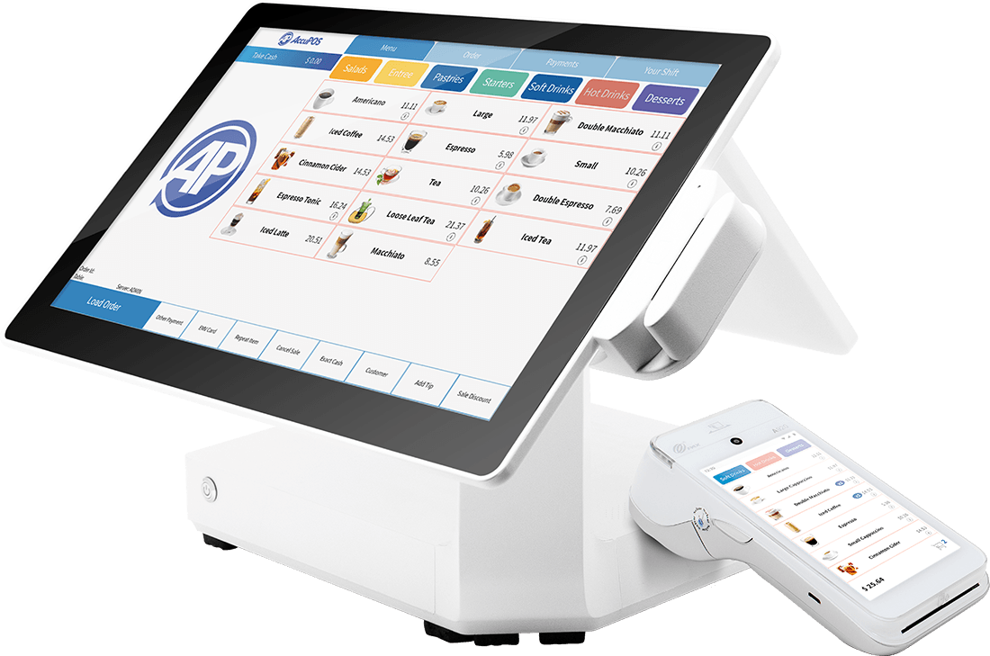
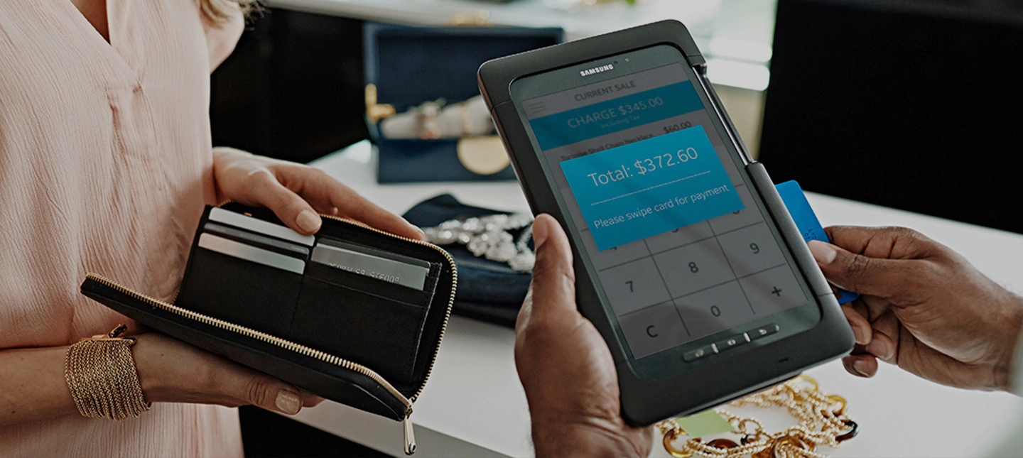
Examples of devices using pos

Slide 4
Problems
Manual method of managing commercial activities . This method is ineffective because it’s may increasing the incidence of errors , time and effort consuming.

Slide 5
Goals of pos system
Reducing time and effort
Performs many tasks
Inventory management
Scalability : As the business grows, a system can be easily scaled to handle the increasing in transactions and data.
Cost saving
Mobile phone support : system designed to work with mobile devices and can process transactions from anywhere.

Slide 6
System users
Procurement
Accountant
Seller
Admin
The Administrator can control and view any thing within the system.
The Seller can access only selling dashboard and sell products.
The Procurement only manage inventory can be accessed and purchased products.
The Accountant can only access Transactions management page.

Slide 7
implementation
Lets go to see the demo.

Slide 8
Conclusion
And I have now come to the end of my presentation. In short , I talked about the POS system and what problems led us to the functioning of the system and the goals of the system track sales and inventory, and provide real-time data to the administrator. The scope of the project includes creating a website application that meets these requirements.

